Slide 1

EDA Of NiFTY-50
The NIFTY 50 is a benchmark Indian stock market index that represents the weighted average of 50 of the largest Indian companies listed on the National Stock Exchange.
By Satish Jadhav.

Slide 2
CONTENT
1.Date 9. Close
2.Company Names 10. VWAP
3.Series 11. Volume
4.Prev Close 12. Turnover
5.Open 13. Deliverable Volume
6.High 14. %Deliverable
7.Low
8.Last

Slide 3
DATA IMPORTING,CLEANING & MANipulation
50 CSV DATA FILES IMPORTED AND MERGED INTO SINGLE CSV FILE.
DROPED NULL VALUES ,NULL COLUMNS FROM DATA SET FOR EASE OF CALCULATION.
RENAMED SOME COLUMN NAMES FOR SAKE OF UNDERSTANDING.
CALCULATED MIN(),MAX(),MEAN(),VAR(),STD() VALUES FROM COLUMNS OF DATASET.
SET INDEX DEFAULT TO COMPANY NAME.
PERFORMED GROUPBY OPERATIONS ON SOME COLUMNS TO GET COLLECTIVE RESULTS.
PLOTED SOME GRAPHS ON GROUPBY COLUMNS TO GET VISUAL LOOK.
CORELATION BETWEEN TWO COLUMNS CALCULED BY USING CORR() FUNCTION.

Slide 4
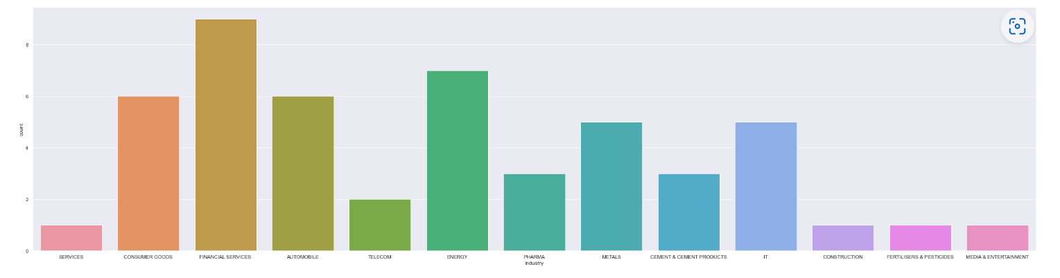
coMPANYS from Different industry

Slide 5
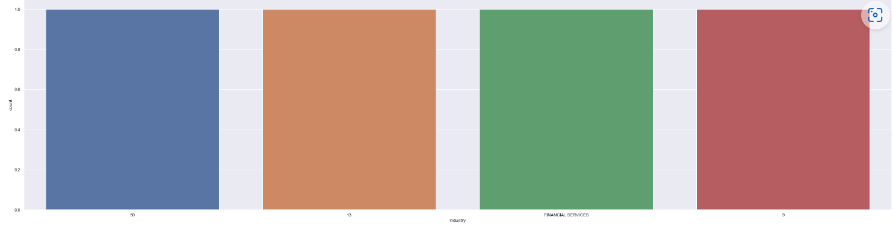
Top industry

Slide 6
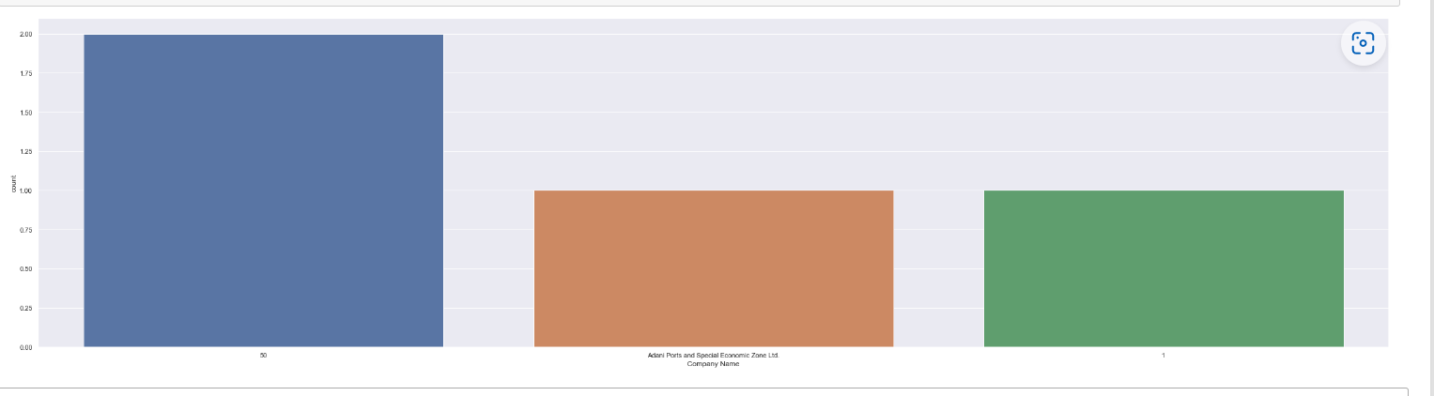
Top company

Slide 7
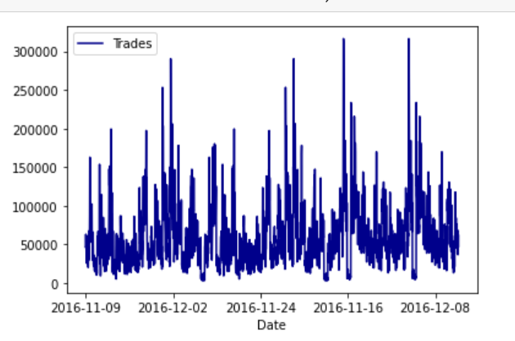
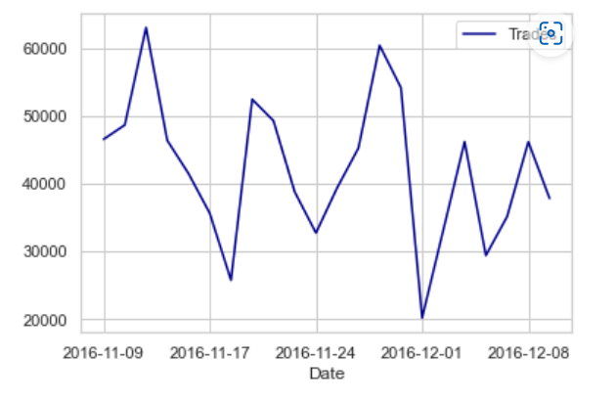
DEMONETIZATION EFFECT ON NIFTY-50 COMPANY’S & ON Adani Ports and Special Economic Zone Ltd.

Slide 8
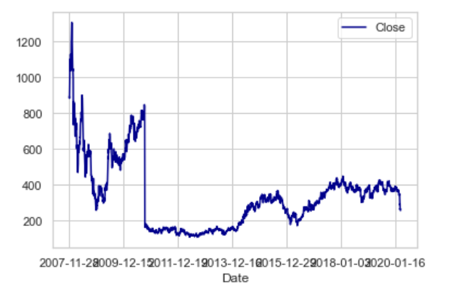
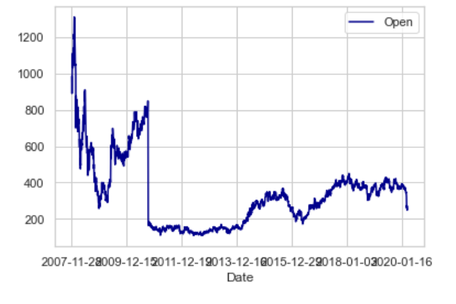
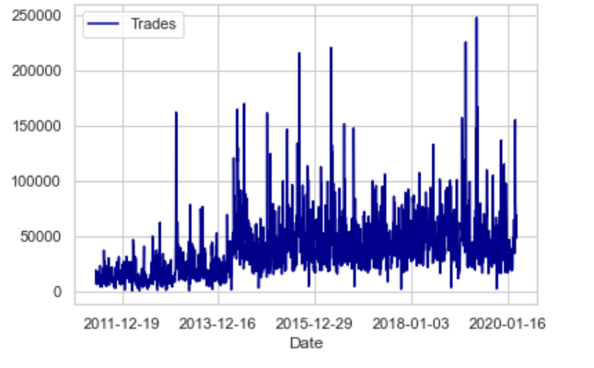
ADANIPORT
BEFORE COVID

Slide 9
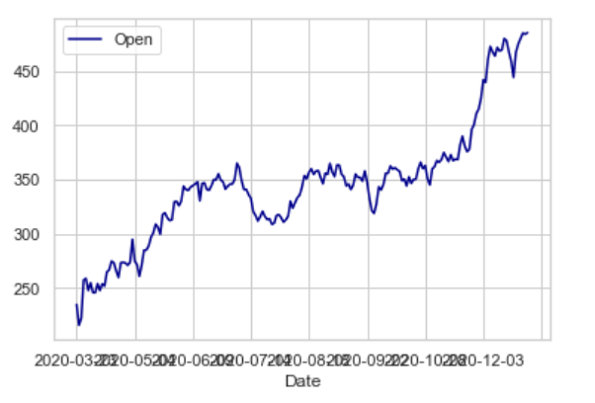
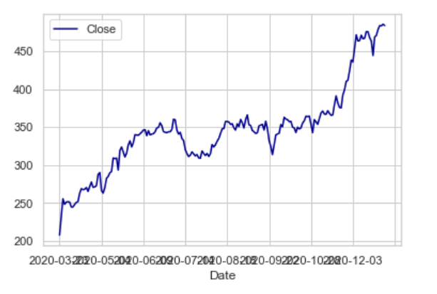
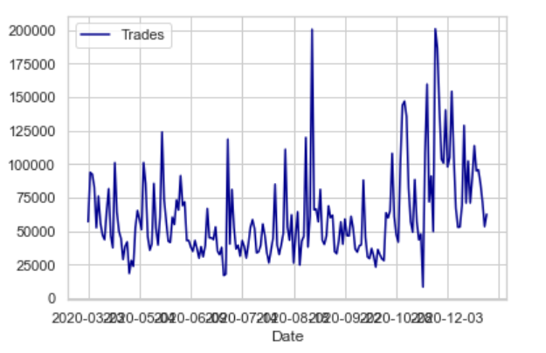
IN Covid period

Slide 10
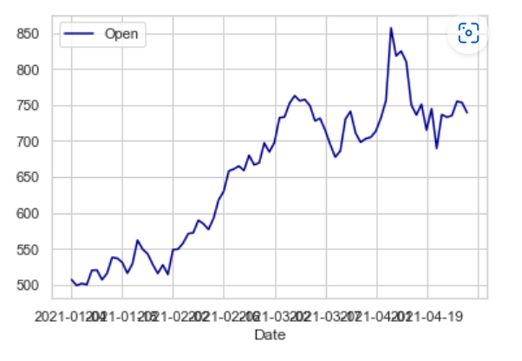
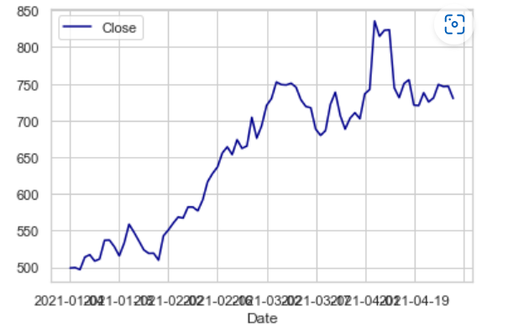
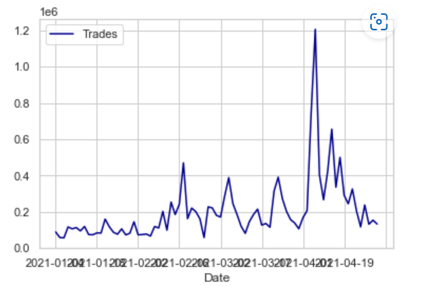
After covid

Slide 11
Thank YOU!

